Slide 1
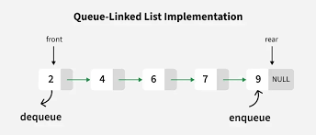
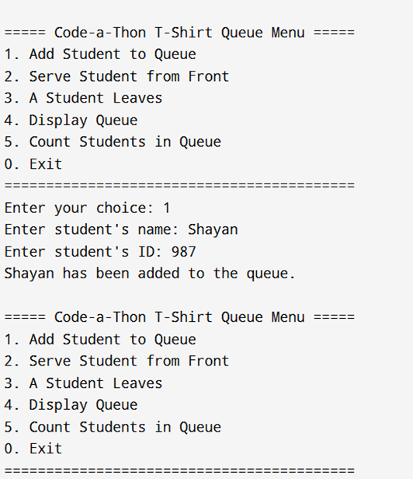
Problem Statement: The "Code-a-Thon" T-Shirt Queue
bool RemoveStudentById(int Id) {// tick
if (head == nullptr) {
cout << "queue is empty.\n";
return false;
}
Node* temp = head;
if (head->id == Id) {//start
head = head->next;
delete temp;
return true;
}
while (temp->next && (temp->next)->id != Id) {
temp = temp->next;
}
if (temp->next == nullptr) {
cout << "ID not found.\n";
return false;
}
Node* cur = temp->next;
temp->next = cur->next;
if (cur == tail) {
tail = temp;
}
delete cur;
return true;
}
Start the program and create an empty queue for students.
Each student has:
A name
A unique ID
A link to the next student (to form a chain).
Main menu options:
Add Student: Ask for the student’s name and ID. Add them to the end of the queue.
Serve Student: The first student in the queue gets their T-shirt. Remove them from the front of the queue. If no one is waiting, show “Queue is empty”.
Student Leaves: Ask for a student’s ID. Find and remove that student from any position in the queue. If the ID is not found, show “ID not found”.
Display Queue: Show the list of students from front to back, with their names and IDs.
Count Students: Count how many students are currently in the queue and display the total.
The menu repeats until the user chooses to Exit.
End the program and show total execution time (how long the program ran).
head
tail
Serve student
Add Student
User Interface Exactly Looks Like
I used a linked list instead of an array because its size is dynamic, and I don’t know how many students will join the queue. When a student leaves or gets served, removing them in a linked list is faster and more efficient since it doesn’t require shifting the entire array. As the system only needs to manage the first (head) and last (tail) student for quick additions and removals, I used pointers for both ends. Overall, I implemented around five to six simple functions that fulfill all the program’s requirements efficiently.

